Slide 1


SAT & ACT Analysis
GENERAL ASSEMBLY PROJECT 1
By: Matthew Lio

Slide 2

Contents
Background
Problem Statement
Data Analysis for Schools
Data Analysis for College Majors
Summary Statistics
Conclusion and Recommendations

Slide 3



Background: What you need to know
SAT & ACT
To measure your readiness for college
One standardized score
Easy for colleges to compare all applicants
Higher score, more college options

Slide 4


Background: What you need to know
SAT & ACT
Mandatory for admittance for some colleges
Increase your chance of admittance (even if they are not compulsory)

Slide 5


Problem Statement
Recommendations on what SAT/ACT score you should aim for
Ideal college
College major
College score requirements
Number of applicants
Acceptance rate
College major score requirements

Slide 6

Data Analysis for Schools
SAT vs ACT Scores
Acceptance Rate
Scores vs No. of Applicants
Top schools & Ivy League
Best non-Ivy schools in each state
Average Schools

Slide 7
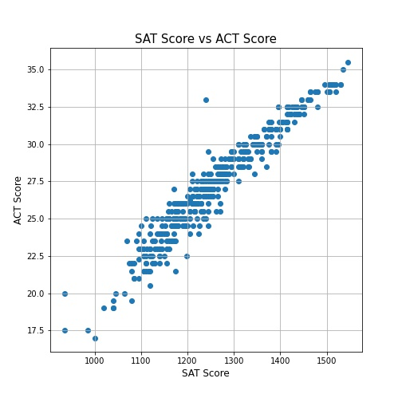
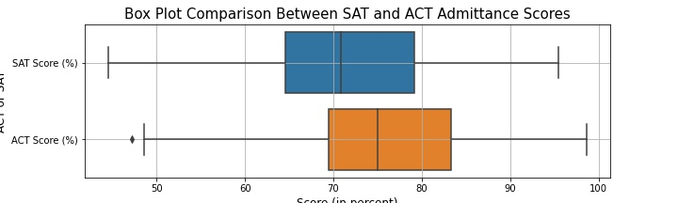
Data Analysis for Schools: SAT vs ACT Scores
Correlation
In general, schools require a higher ACT than SAT for admission
ACT requirement ~3% higher mean score than SAT

Slide 8
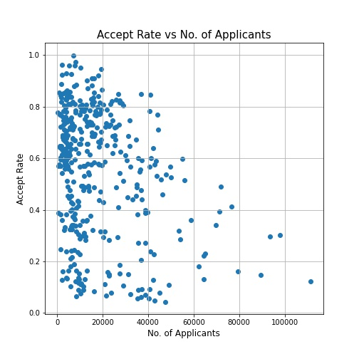
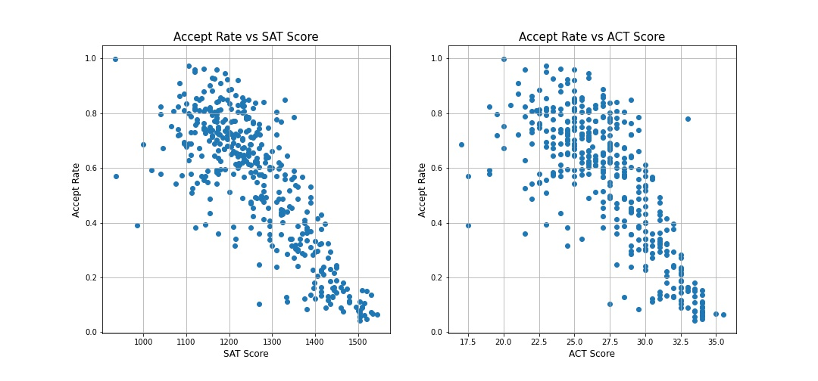
Data Analysis for Schools: Acceptance Rate
Acceptance rate vs test score
Negative correlation:
Higher the admission test scores, lower the acceptance rates
Acceptance rate vs number of applicants
Slight correlation:
School’s acceptance rates lower, with increase in applicants

Slide 9
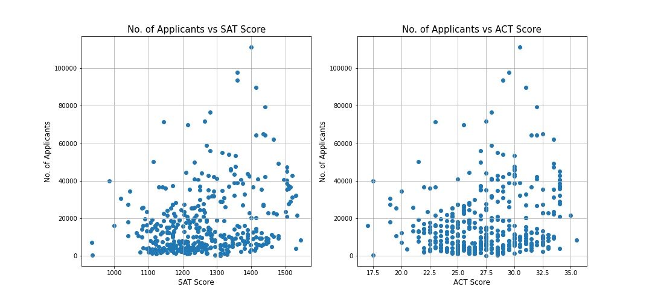
Data Analysis for Schools: Scores vs No. of Applicants
Slight correlation
Schools’ admittance scores increase with more applicants

Slide 10
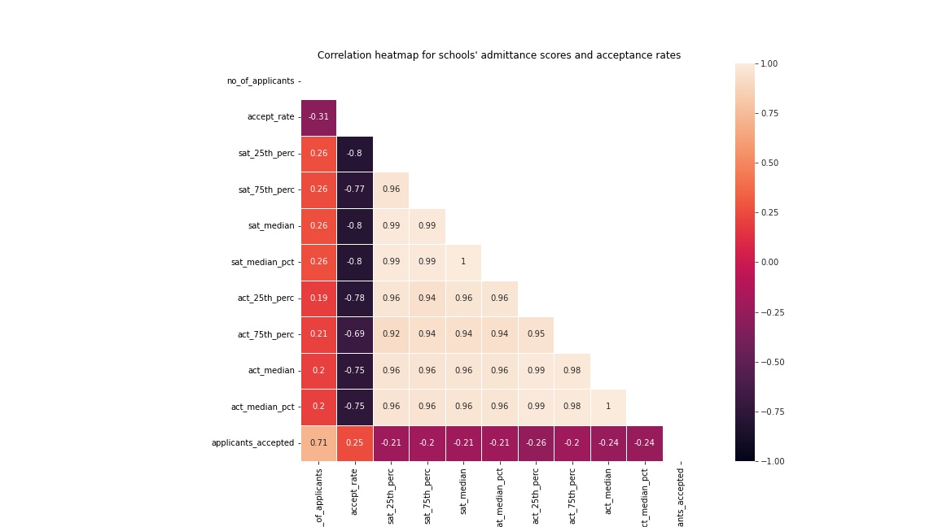
Data Analysis for Schools
Correlation Summary
Higher the admission test scores, lower the acceptance rates
School’s acceptance rates tend to lower as number of applicants increase
Admission scores tend to increase with number of applicants

Slide 11
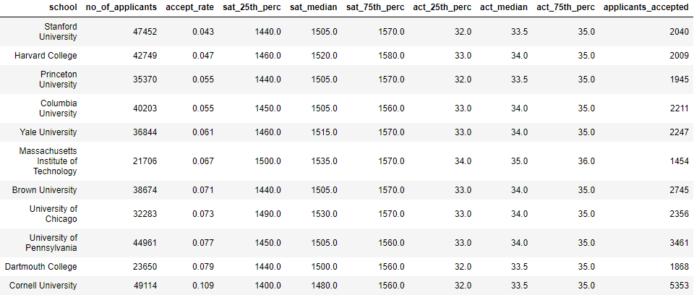
Data Analysis for Schools: Top schools & Ivy League
SAT 1400, ACT 32: Low chance of admittance to Ivy League schools
Less than 3000 spots (except for Cornell University)
Acceptance rates lower than 10% (except for Cornell University)
Easiest Ivy League to enroll: Cornell University

Slide 12
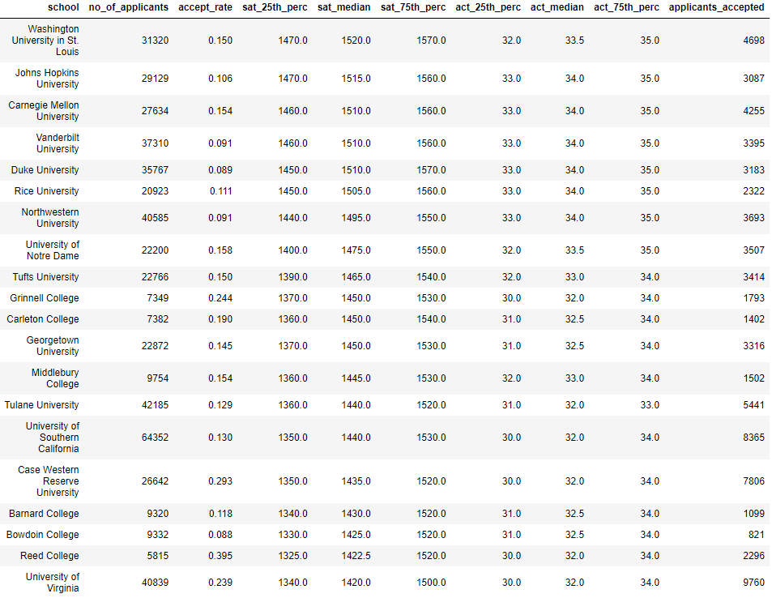
Data Analysis for Schools: Best non-Ivy schools in each state
25th percentile mean scores: SAT 1296, ACT 29
Minimum scores for admittance for all non-Ivy best colleges in each state

Slide 13
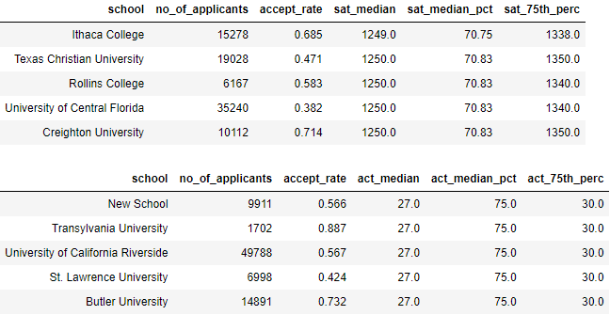
Data Analysis for Schools: Average schools
These schools still require a relatively high score for admittance:
SAT 1250, ACT 27
For high chances of admittance:
SAT 1350, ACT 30

Slide 14
Data Analysis for College Majors
SAT Total Scores
R&W vs Math

Slide 15
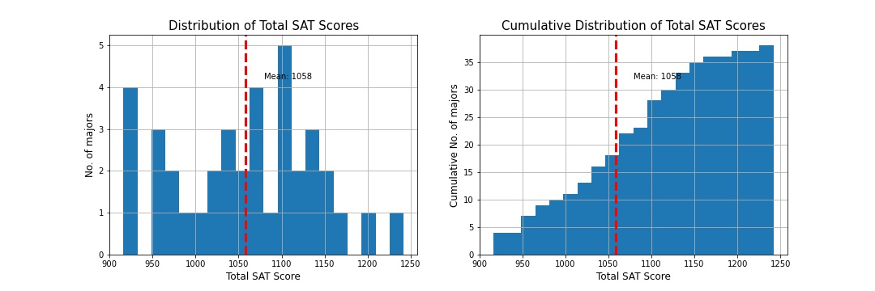
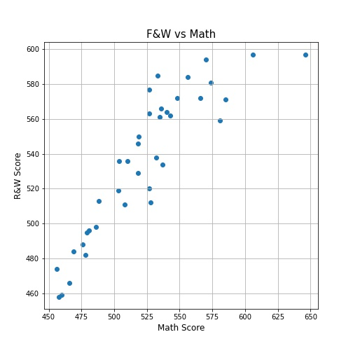
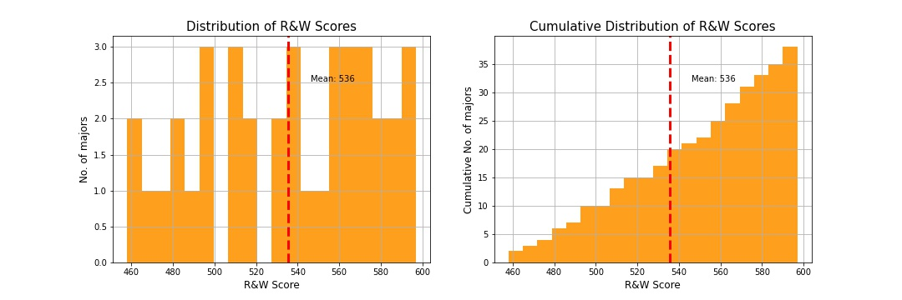
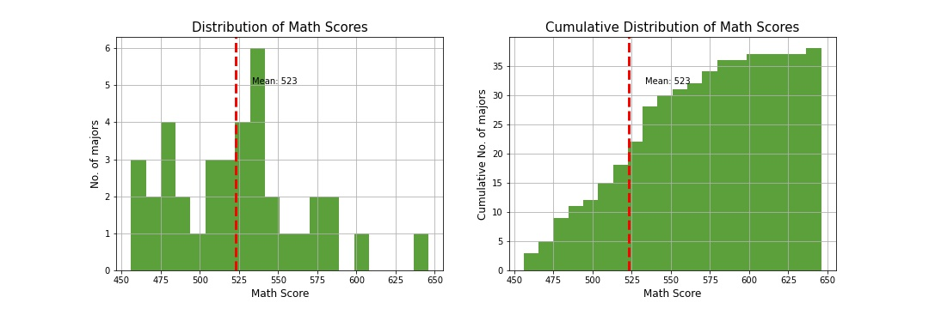
Data Analysis for College Majors
R&W mean score: 536
Math mean score: 523
Total Mean score: 1058
Most test takers did better on R&W as compared to Math

Slide 16
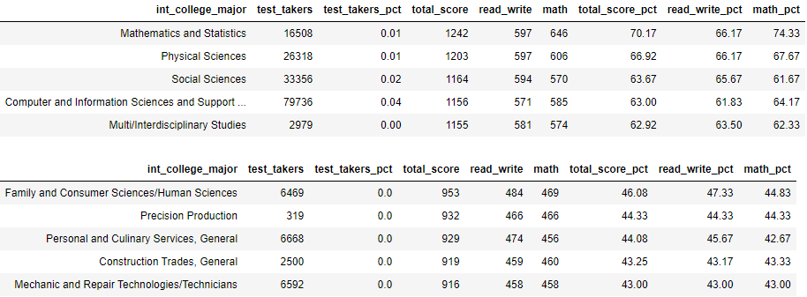
Data Analysis for College Majors
SAT scores from applicants set the score requirement into these majors
Recommended to score similar or higher than these mean scores for a higher chance of acceptance
Scores for each section to aim for
Above R&W 597
Above Math 646
(As these scores are still an average)

Slide 17
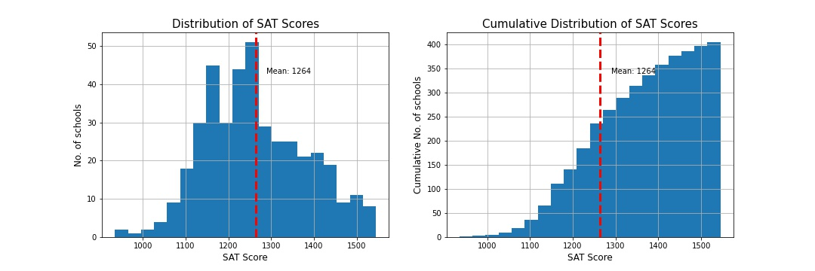
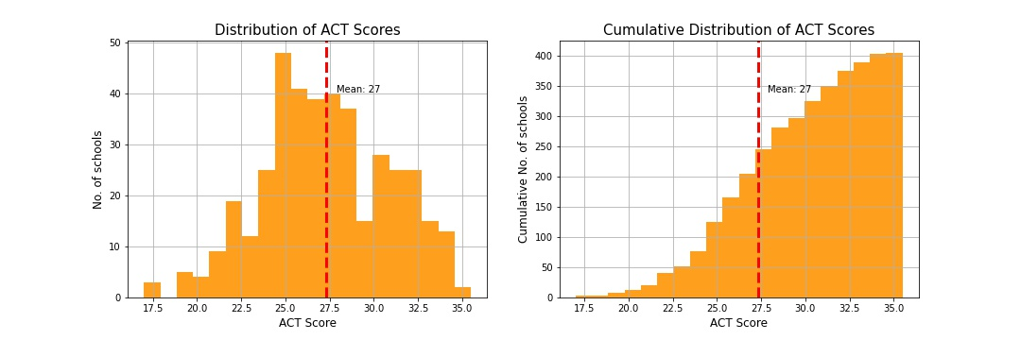
Summary Statistics
SAT | ACT | Acceptance chance* | Percentage of schools*
1070 | 22 | Low chance | 25% of schools
1175 | 25 | Medium chance | 25% of schools
1270 | 28 | High chance | 25% of schools
1150 | 24 | Low chance | 50% of schools
1250 | 27 | Medium chance | 50% of schools
1350 | 30 | High chance | 50% of schools
1250 | 28 | Low chance | 75% of schools
1350 | 30 | Medium chance | 75% of schools
1440 | 32 | High chance | 75% of schools
*All chances are an average based on the percentiles (25, 50, 75 percentiles as shown in the table) and percentage of schools.

Slide 18

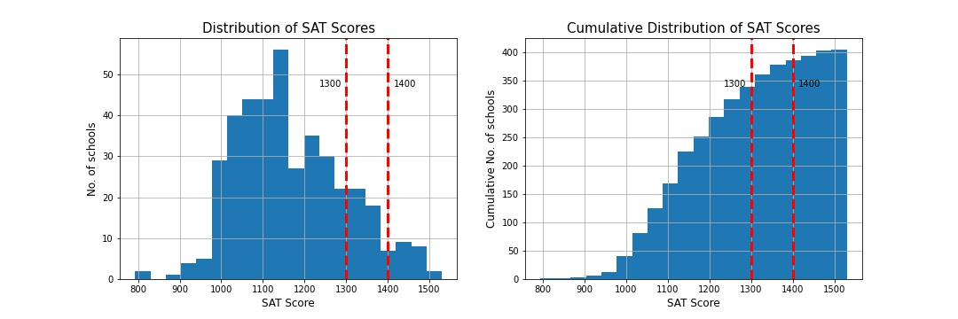
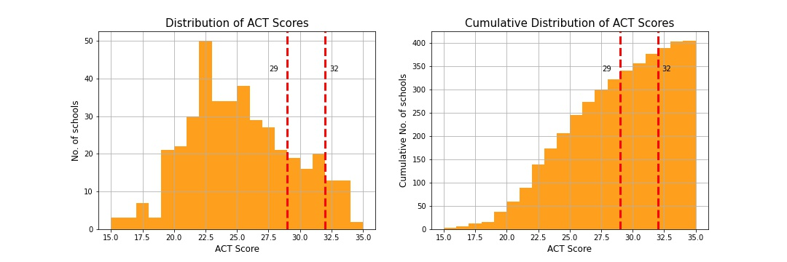
Conclusions & Recommendations
SAT: 1300 – 1400
ACT: 29 – 32
SAT 1400, ACT 32: Unlocks a shot for Cornell University (Ivy League)
SAT 1300, ACT 29: Best non-Ivy schools in any state becomes available
Very good chance for any average schools
Anywhere in between, increase chances for best non-Ivy schools in any state

Slide 19
THANK YOU

